Slide 2
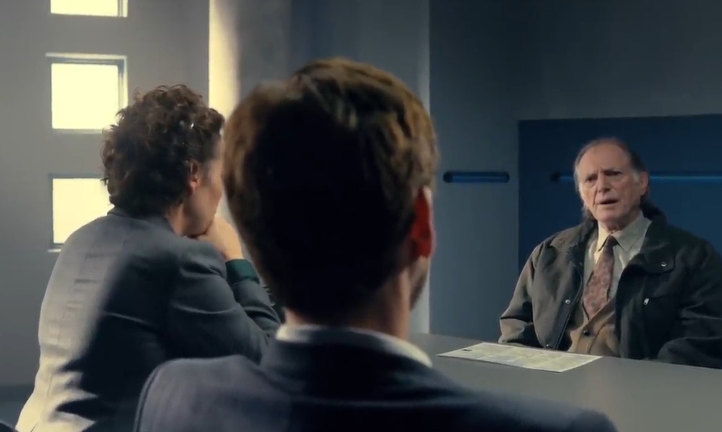
Innocent
Imagine that you are a friend of the victim
100%
50%
0%
50%
100%
Guilty
0% Certain

Slide 3
Innocent
Imagine that you are a friend of the victim
100%
50%
0%
50%
100%
Guilty
25% Certain

Slide 4
Innocent
Imagine that you are a friend of the victim
100%
50%
0%
50%
100%
Guilty
65% Certain

